Slide 1
CSC 422/522 Computer Vision and Pattern Recognition
Pinhole Camera and Perspective Projection
2026 Spring

Slide 2

Today
Learn basics of image formation
An overlapping area for computer vision and computer graphics (especially rendering)
Focusing on the geometric side
Pinhole camera
Coordinate system
Perspective projection
Hello Again!

Slide 3

Brief Introduction: Rendering
An image rendered using POV-Ray 3.6. (Source: https://en.wikipedia.org/wiki/Rendering_(computer_graphics))

Slide 4
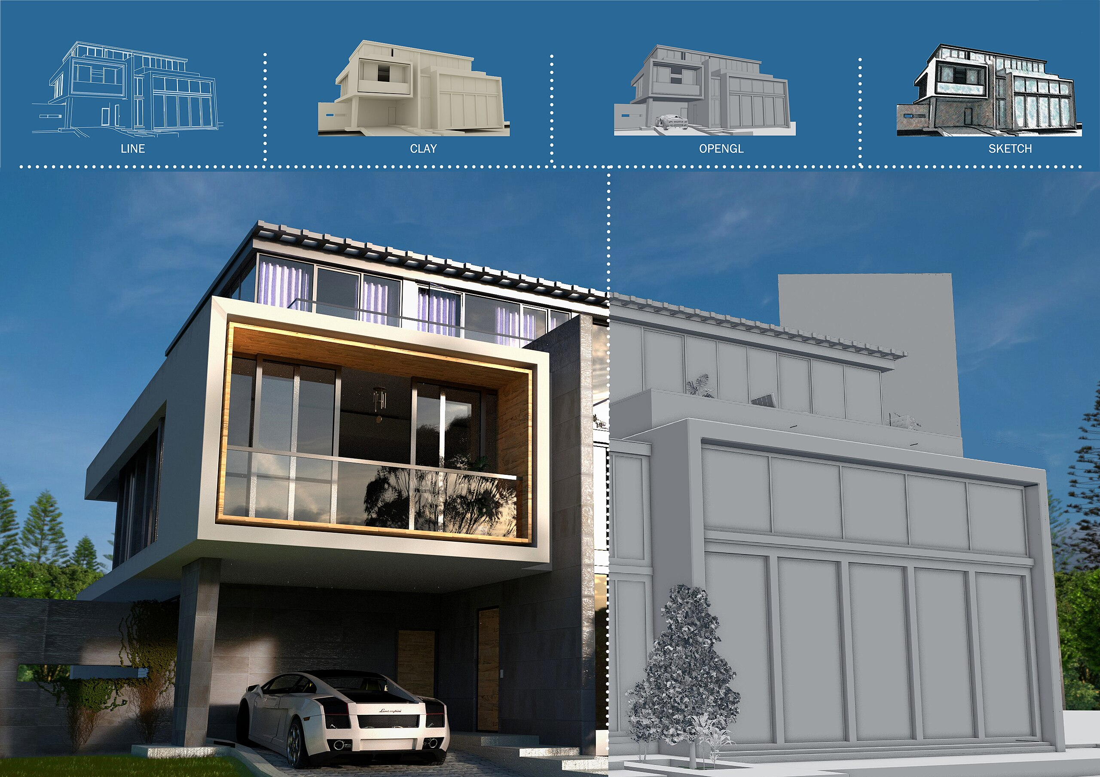
Definition
Rendering is the process of generating a photorealistic or non- photorealistic image from input data such as 3D models, using a computer program.
Image source: https://upload.wikimedia.org/wikipedia/commons/thumb/3/3c/Architectural_render_02_%28Blender%29.jpg/2560px-Architectural_render_02_%28Blender%29.jpg

Slide 5
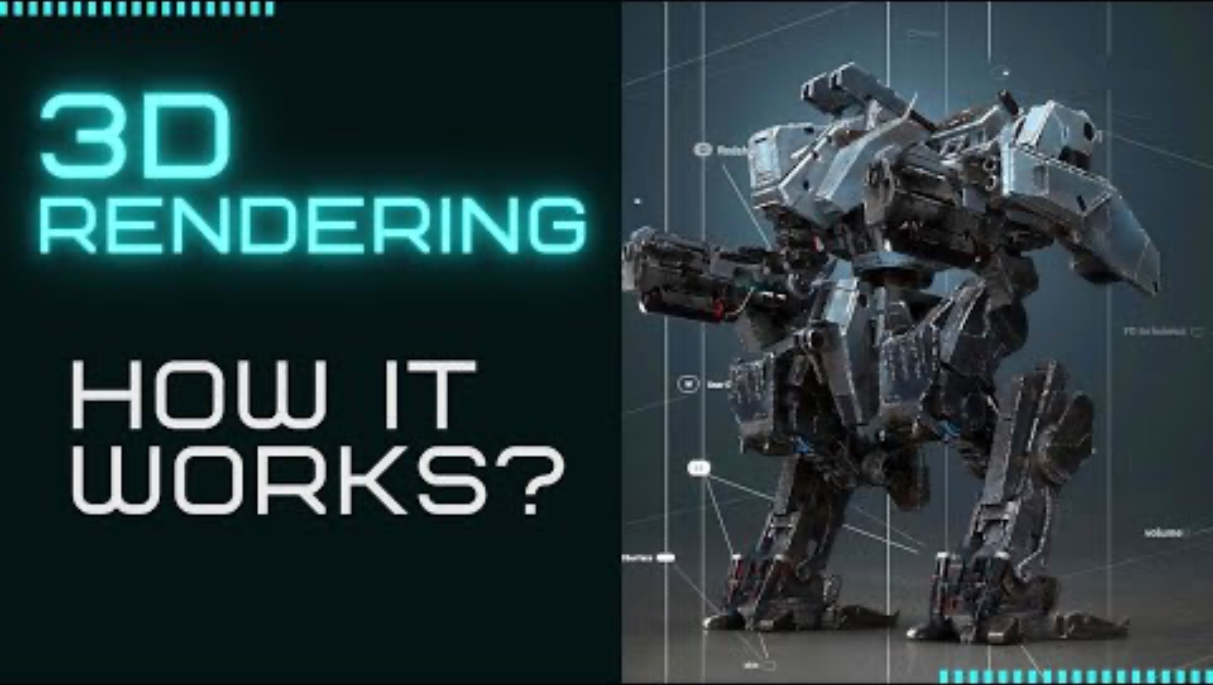
Example: How Rendering Works in Games
URL: https://youtu.be/k6XVSqSVA5s?si=4-F48dzv6Xh2qq-g

Slide 6

Photometric Image Formation?
In this course, we will learn how 3D geometric features in the world are projected into 2D features in an image (e.g., where are the 3D points projected in the 2D image?)
However, images are not composed of 2D features. Instead, they are made up of discrete color or intensity values.
Where do these values come from?
Illustration generated by ChatGPT. Is it good or not?

Slide 7
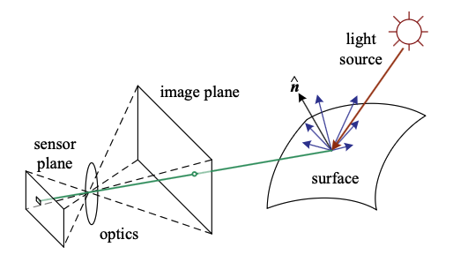
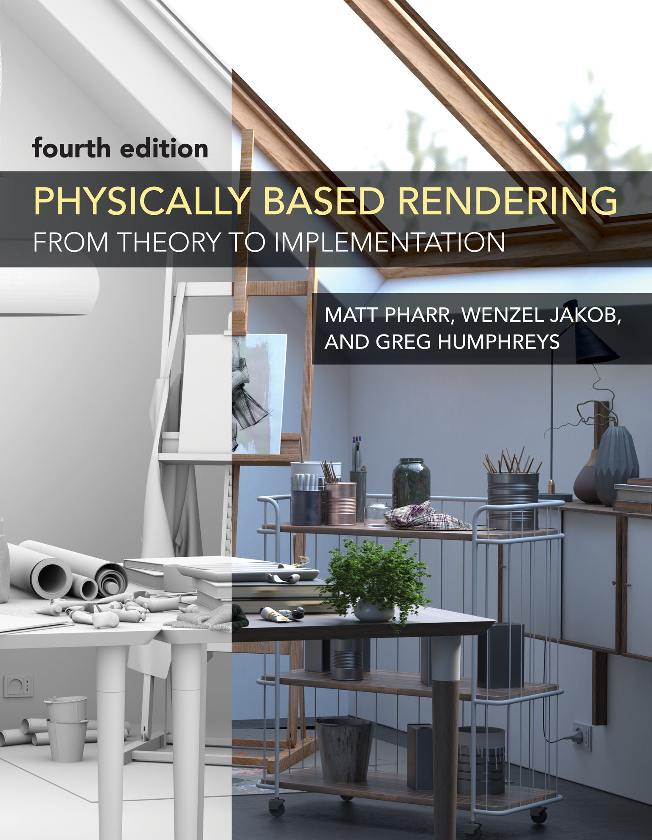
Photometric Image Formation?
Image from Computer Vision: Algorithms and Applications, 2nd ed (Figure 2.14)
A simplified model of photometric image formation: Light is emitted by one or more light sources and is then reflected from an object’s surface.
A portion of this light is directed towards the camera. This simplified model ignores multiple reflections, which often occur in real-world scenes.
Optional reading: physically based rendering (e.g., https://pbrt.org), if you are interested!

Slide 8

Pinhole Camera: The Simplest Type of Camera
Source: https://en.wikipedia.org/wiki/Photography

Slide 9
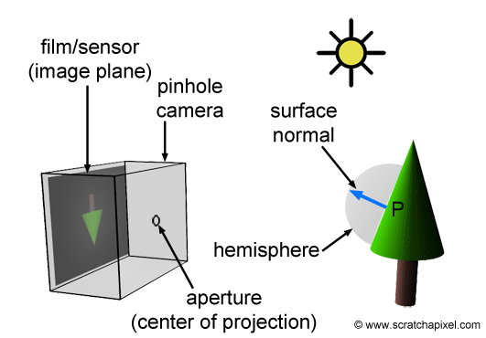
How Does a Real Camera Work?
In a real camera, images are created when light falls on a surface sensitive to light.
Film camera: film
Digital camera: sensor or Charge-Coupled Device (CCD).
In the real world, when light from a light source reaches an object, it is reflected in many directions. However, only one ray travels in the direction of the camera and hits the film's surface or the CCD, as illustrated.
Image source: https://www.scratchapixel.com/lessons/3d-basic-rendering/3d-viewing-pinhole-camera/how-pinhole-camera-works-part-1.html

Slide 10
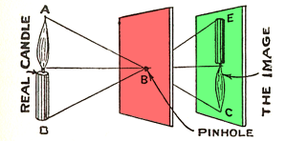
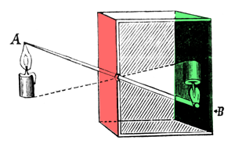
Pinhole Cameras
The pinhole camera and camera obscura principle illustrated in 1925, in The Boy Scientist.
This illustration depicts the simplicity and fundamental mechanics of the pinhole camera model, highlighting its significance in the evolution of photographic techniques.
Reference: https://www.scratchapixel.com/lessons/3d-basic-rendering/3d-viewing-pinhole-camera/how-pinhole-camera-works-part-1.html

Slide 11
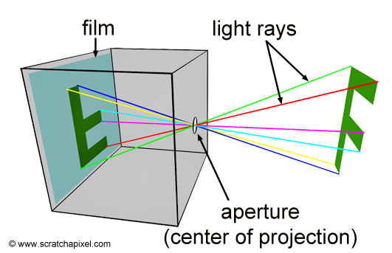
Pinhole Cameras
The simplest type of camera.
It consists of a simple, lightproof box with a very small hole in the front, known as an aperture, and some light-sensitive film or paper placed inside the box on the side facing this pinhole.
To take a picture, you simply open the aperture to expose the film to light.
Image source: https://www.scratchapixel.com/lessons/3d-basic-rendering/3d-viewing-pinhole-camera/how-pinhole-camera-works-part-1.html

Slide 12
A Virtual Pinhole Camera Model (Part 1)
You may have noticed that the pinhole camera models generate inverted image.
Object Pinhole Image plane
↑ • ↓
In computer graphics and computer vision, most visualizations do something different.
Object Image plane Camera center
↑ ↑ •
(this is called a virtual image plane)

Slide 13
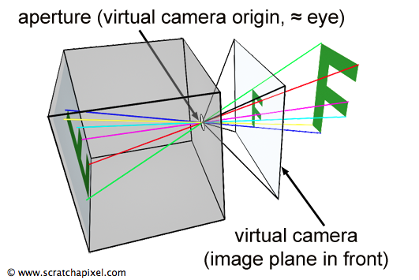
A Virtual Pinhole Camera Model (Part 2)
Image source: https://www.scratchapixel.com/lessons/3d-basic-rendering/3d-viewing-pinhole-camera/virtual-pinhole-camera-model.html
Why?

Slide 14
A Virtual Pinhole Camera Model (Part 3)
In real world, the image plane cannot be located in front of the aperture.
In the virtual world of computers, constructing our camera in this manner is feasible.
This way, the projected image of the scene on the image plane is not inverted.
The real-world and virtual models are equivalent (the difference is just a sign conversion)
Image source: https://www.scratchapixel.com/lessons/3d-basic-rendering/3d-viewing-pinhole-camera/virtual-pinhole-camera-model.html

Slide 15
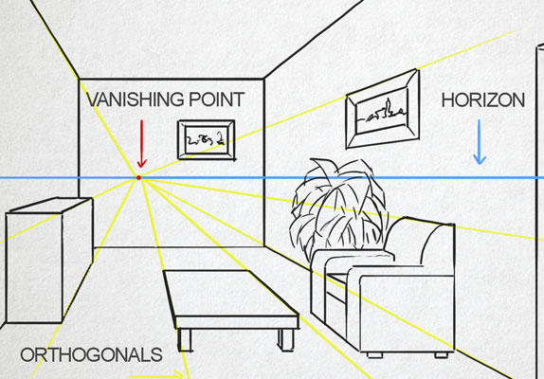
Perspective Projection of a 3D Point
Image source: https://thevirtualinstructor.com/onepointperspective.html

Slide 16
Goal: Compute the Location on Image Plane
Credit: MIT 16.485, the pdf notes can be found in https://vnav.mit.edu/material/11-ImageFormation-notes.pdf

Slide 17
Using the Similarity of Triangles ☺

Slide 18
Conversion to Pixels
Terminologies:
[o_{x}, o_{y}] is called the principal point
s_{x}f is the focal length in horizontal pixels (usually denoted as f_{x})
s_{y}f is the focal length in vertical pixels (usually denoted as f_{y})

Slide 19
Convention of Image Coordinate System (e.g., in OpenCV)
u increases
The origin (0,0) corresponds to the top-left corner.
The x (i.e., u) values go left-to-right (column number).
The y (i.e., v) values go top-to-bottom (row number).
v increases

Slide 20
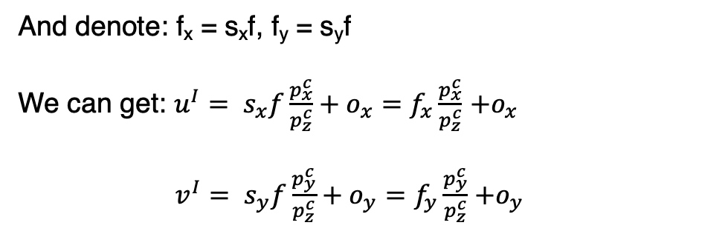
The Full Equation from 3D Point to Pixel
And denote: f_{x} = s_{x}f, f_{y} = s_{y}f
We can get: $u^{I}= s_{x}f\frac{p_{x}^{c}}{p_{z}^{c}}+o_{x}=f_{x}\frac{p_{x}^{c}}{p_{z}^{c}}$ $+o_{x}$
$v^{I}= s_{y}f\frac{p_{y}^{c}}{p_{z}^{c}}+o_{y}=f_{y}\frac{p_{y}^{c}}{p_{z}^{c}}$ $+o_{y}$

Slide 21
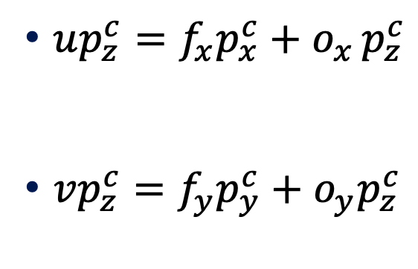
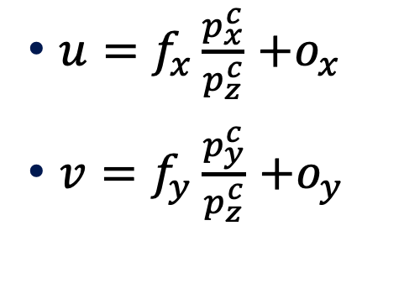
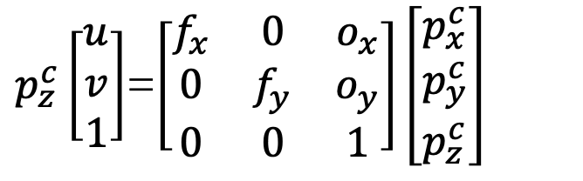
Can we obtain a more concise equation?
$u=f_{x}\frac{p_{x}^{c}}{p_{z}^{c}}$ $+o_{x}$
$v=f_{y}\frac{p_{y}^{c}}{p_{z}^{c}}$ $+o_{y}$
$up_{z}^{c}=f_{x}p_{x}^{c}+o_{x }p_{z}^{c}$
$vp_{z}^{c}=f_{y}p_{y}^{c}+o_{y}p_{z}^{c}$
$p_{z}^{c}\left[\begin{matrix}u \\ v \\ 1\end{matrix}\right]$=$\left[\begin{matrix}f_{x} & 0 & o_{x} \\ 0 & f_{y} & o_{y} \\ 0 & 0 & 1\end{matrix}\right]\left[\begin{matrix}p_{x}^{c} \\ p_{y}^{c} \\ p_{z}^{c}\end{matrix}\right]$
We can drop the superscript “I”

Slide 22
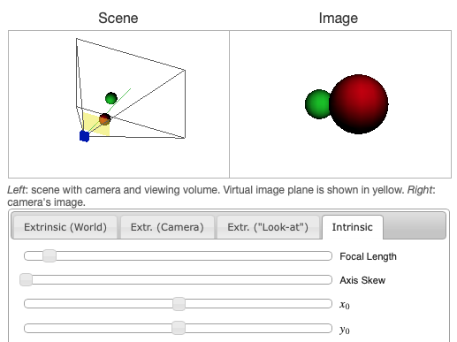
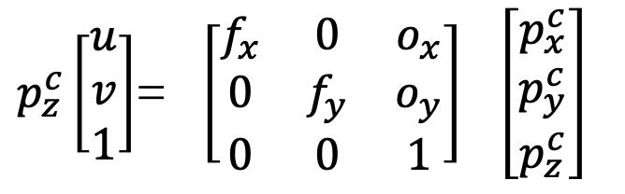
The Intrinsic Matrix K
$p_{z}^{c}\left[\begin{matrix}u \\ v \\ 1\end{matrix}\right]$= $\left[\begin{matrix}f_{x} & 0 & o_{x} \\ 0 & f_{y} & o_{y} \\ 0 & 0 & 1\end{matrix}\right] \left[\begin{matrix}p_{x}^{c} \\ p_{y}^{c} \\ p_{z}^{c}\end{matrix}\right]$
Note: in this course, we assume the pixels are not skewed. Otherwise, the value in the first row, second column will be non-zero.
Notations we use:
[o_{x}, o_{y}] is called the principal point
f_{x} is the focal length in horizontal pixels
f_{y} is the focal length in vertical pixels
Let’s try the perspective camera toy in https://ksimek.github.io/perspective_camera_toy.html

Slide 23
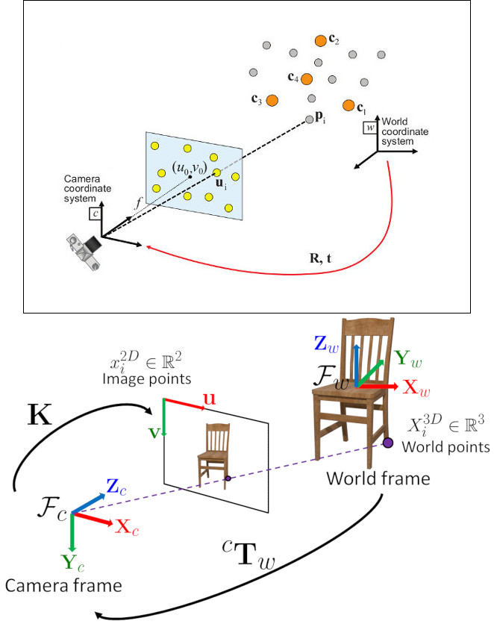
World-to-Camera Transformation
Image source: https://docs.opencv.org/4.x/d5/d1f/calib3d_solvePnP.html

Slide 24
Camera and World Coordinate Systems
Camera Coordinate System
World Coordinate System
It is attached to the camera, and by convention:
Z-axis along the viewing direction
X, Y axes aligned with the image plane
It is a reference frame you choose to describe the scene, which has
An origin (chosen arbitrarily)
Axes (Chosen arbitrarily)
Image source: https://docs.opencv.org/4.x/d5/d1f/calib3d_solvePnP.html

Slide 25


Why need different coordinate systems?
World coordinates do NOT depend on the camera.
Physical analogy: imaging holding a phone camera and walk around the classroom
The classroom doesn’t move (world coordinates)
You walk and change the camera orientations
The camera coordinate system changed

Slide 26
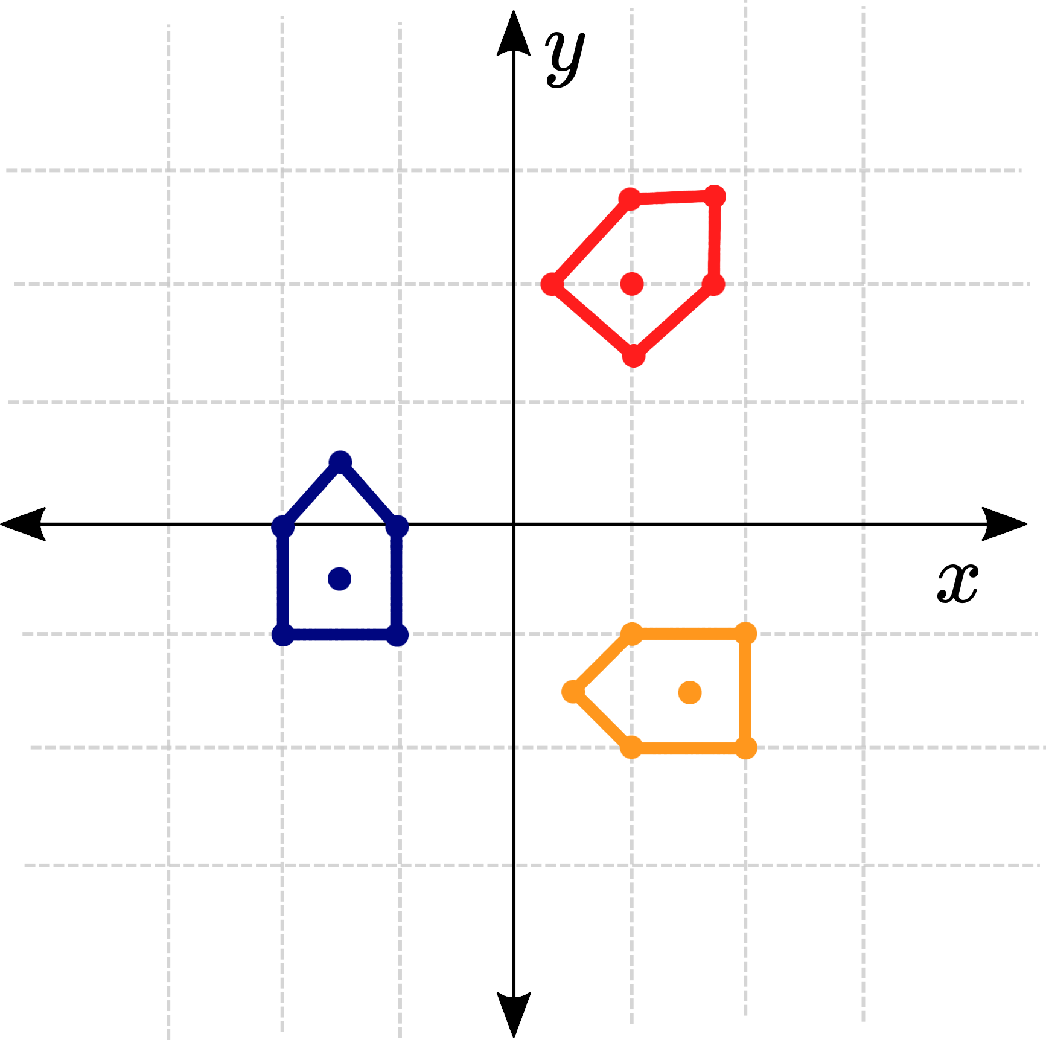
Let’s start with transformations in 2D space…
We focus on rigid transformations including rotations and translations.
Image source: https://articulatedrobotics.xyz/tutorials/coordinate-transforms/coordinate-transforms

Slide 27
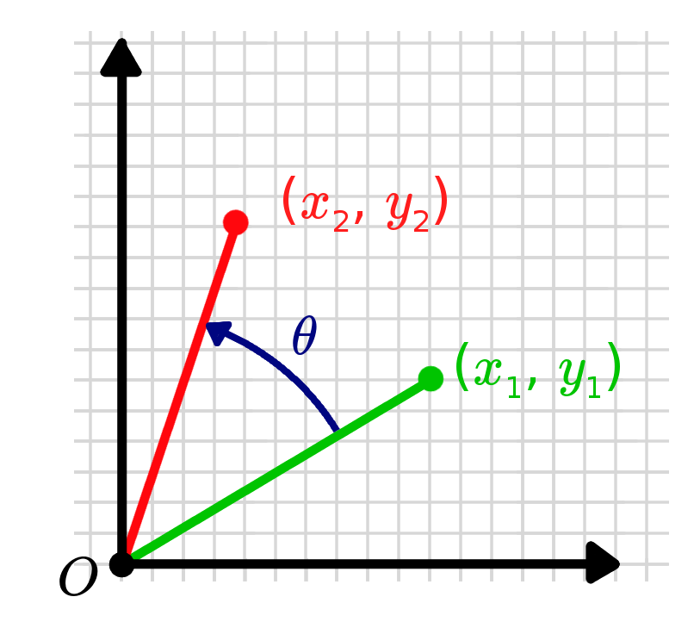
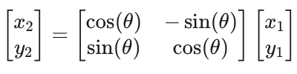
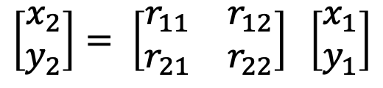
2D Rotation
We can use a 2x2 transformation to describe it.
For the 2D case, we can write down the rotation matrix using the rotation angle easily:
$$\left[\begin{matrix}x_{2} \\ y_{2}\end{matrix}\right]= \left[\begin{matrix}r_{11} & r_{12} \\ r_{21} & r_{22}\end{matrix}\right] \left[\begin{matrix}x_{1} \\ y_{1}\end{matrix}\right]$$
Image source: https://articulatedrobotics.xyz/tutorials/coordinate-transforms/rotation-matrices-2d

Slide 28
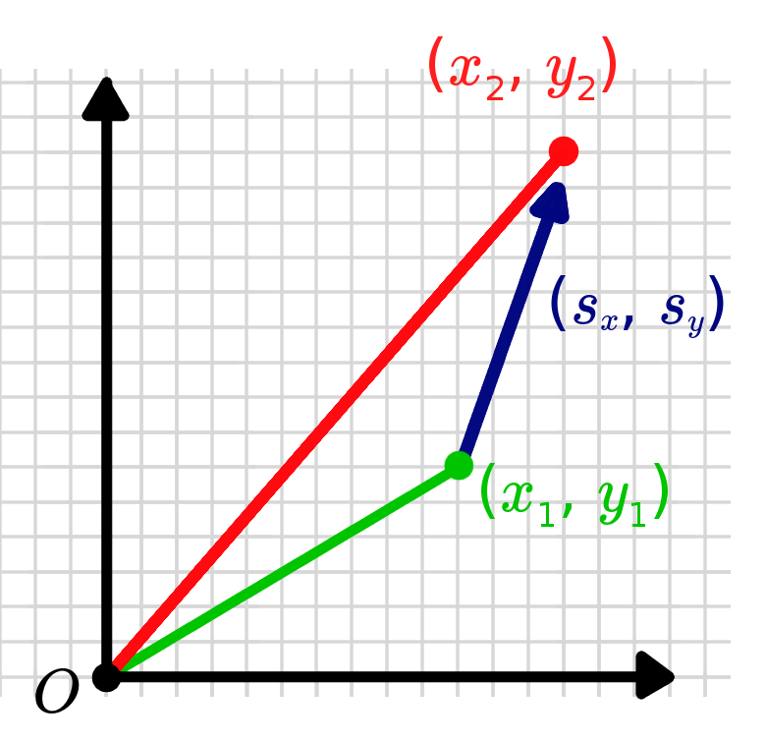
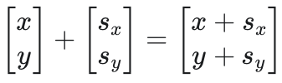
2D Translation
What’s the problem of the above operation?
We would like a nice form like f(p) = Ap, where A is a matrix.
But the above way to perform translation looks like f(p) = p + b, where b is a vector.
When we need to perform multiple transformations, the f(p) = Ap form gives cleaner results.
Reference: https://articulatedrobotics.xyz/tutorials/coordinate-transforms/translations

Slide 29
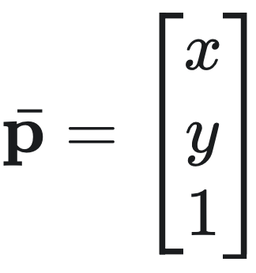
Introducing... Homogeneous Coordinates!
By using a homogeneous coordinate system, we can represent both rotations and translations using a single matrix.
The first thing we have to do is to modify our coordinates, adding a “1” onto the end of our point vector.
Note: you can add a bar ( ˉ ) above the original variable to express that you are working with the homogenous coordinates.
Reference: https://articulatedrobotics.xyz/tutorials/coordinate-transforms/translations

Slide 30
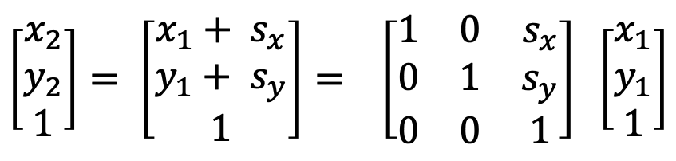
2D Translation Using Homogenous Coordinates
$$\left[\begin{matrix}x_{2} \\ y_{2} \\ 1\end{matrix}\right]= \left[\begin{matrix}x_{1}+ s_{x} \\ y_{1}+ s_{y} \\ 1\end{matrix}\right]= \left[\begin{matrix}1 & 0 & s_{x} \\ 0 & 1 & s_{y} \\ 0 & 0 & 1\end{matrix}\right] \left[\begin{matrix}x_{1} \\ y_{1} \\ 1\end{matrix}\right]$$
Reference: https://articulatedrobotics.xyz/tutorials/coordinate-transforms/translations

Slide 31
2D Translation Using Homogenous Coordinates
$$\left[\begin{matrix}x_{2} \\ y_{2} \\ 1\end{matrix}\right]= \left[\begin{matrix}x_{1}+ s_{x} \\ y_{1}+ s_{y} \\ 1\end{matrix}\right]= \left[\begin{matrix}1 & 0 & s_{x} \\ 0 & 1 & s_{y} \\ 0 & 0 & 1\end{matrix}\right] \left[\begin{matrix}x_{1} \\ y_{1} \\ 1\end{matrix}\right]$$
We get a nice form like f(p) = Ap, where A is a matrix ☺
Why is it called homogenous? Because (x, y, 1) ~ (kx, ky, k), i.e., they represent the same point after normalization.
Reference: https://articulatedrobotics.xyz/tutorials/coordinate-transforms/translations

Slide 32
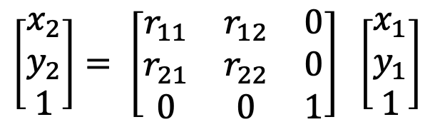
2D Rotation Using Homogenous Coordinates
$$\left[\begin{matrix}x_{2} \\ y_{2}\end{matrix}\right]= \left[\begin{matrix}r_{11} & r_{12} \\ r_{21} & r_{22}\end{matrix}\right] \left[\begin{matrix}x_{1} \\ y_{1}\end{matrix}\right]$$
$$\left[\begin{matrix}x_{2} \\ y_{2} \\ 1\end{matrix}\right]= \left[\begin{matrix}r_{11} & r_{12} & 0 \\ r_{21} & r_{22} & 0 \\ 0 & 0 & 1\end{matrix}\right] \left[\begin{matrix}x_{1} \\ y_{1} \\ 1\end{matrix}\right]$$
Image source: https://articulatedrobotics.xyz/tutorials/coordinate-transforms/rotation-matrices-2d

Slide 33
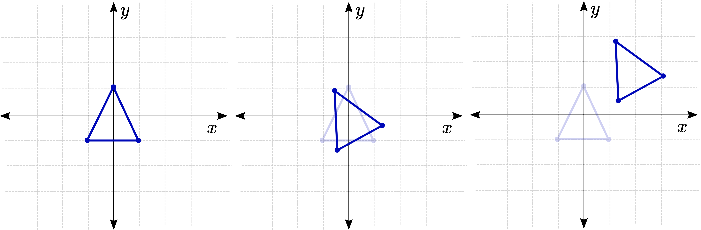
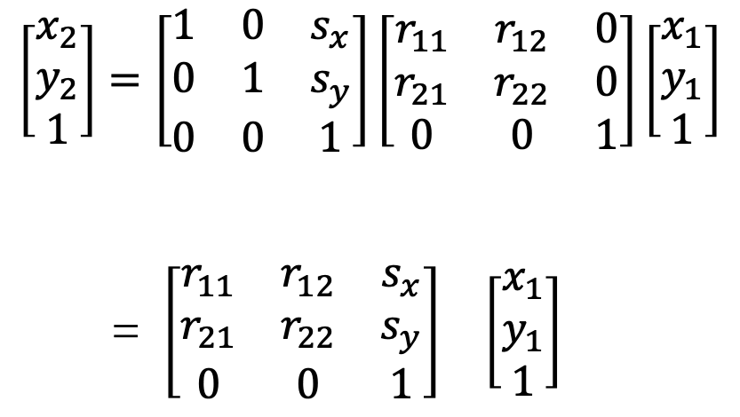
2D Transformation Matrix (Rotation + Translation) “T”, Using Homogenous Coordinates
$$\left[\begin{matrix}x_{2} \\ y_{2} \\ 1\end{matrix}\right]=\left[\begin{matrix}1 & 0 & s_{x} \\ 0 & 1 & s_{y} \\ 0 & 0 & 1\end{matrix}\right]\left[\begin{matrix}r_{11} & r_{12} & 0 \\ r_{21} & r_{22} & 0 \\ 0 & 0 & 1\end{matrix}\right]\left[\begin{matrix}x_{1} \\ y_{1} \\ 1\end{matrix}\right]$$
= $\left[\begin{matrix}r_{11} & r_{12} & s_{x} \\ r_{21} & r_{22} & s_{y} \\ 0 & 0 & 1\end{matrix}\right]$ $\left[\begin{matrix}x_{1} \\ y_{1} \\ 1\end{matrix}\right]$
Image source: https://articulatedrobotics.xyz/tutorials/coordinate-transforms/transformation-matrices
T

Slide 34
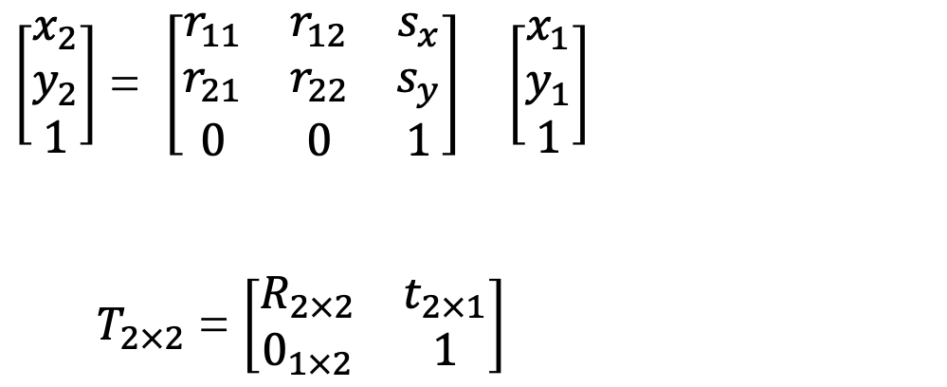

Extension to n-Dimensional Space
$\left[\begin{matrix}x_{2} \\ y_{2} \\ 1\end{matrix}\right]$ = $\left[\begin{matrix}r_{11} & r_{12} & s_{x} \\ r_{21} & r_{22} & s_{y} \\ 0 & 0 & 1\end{matrix}\right]$ $\left[\begin{matrix}x_{1} \\ y_{1} \\ 1\end{matrix}\right]$
$T_{2×2}$ = $\left[\begin{matrix}R_{2×2} & t_{2×1} \\ 0_{1×2} & 1\end{matrix}\right]$
$T_{n×n}$ = $\left[\begin{matrix}R_{n×n} & t_{n×1} \\ 0_{1×n} & 1\end{matrix}\right]$

Slide 35
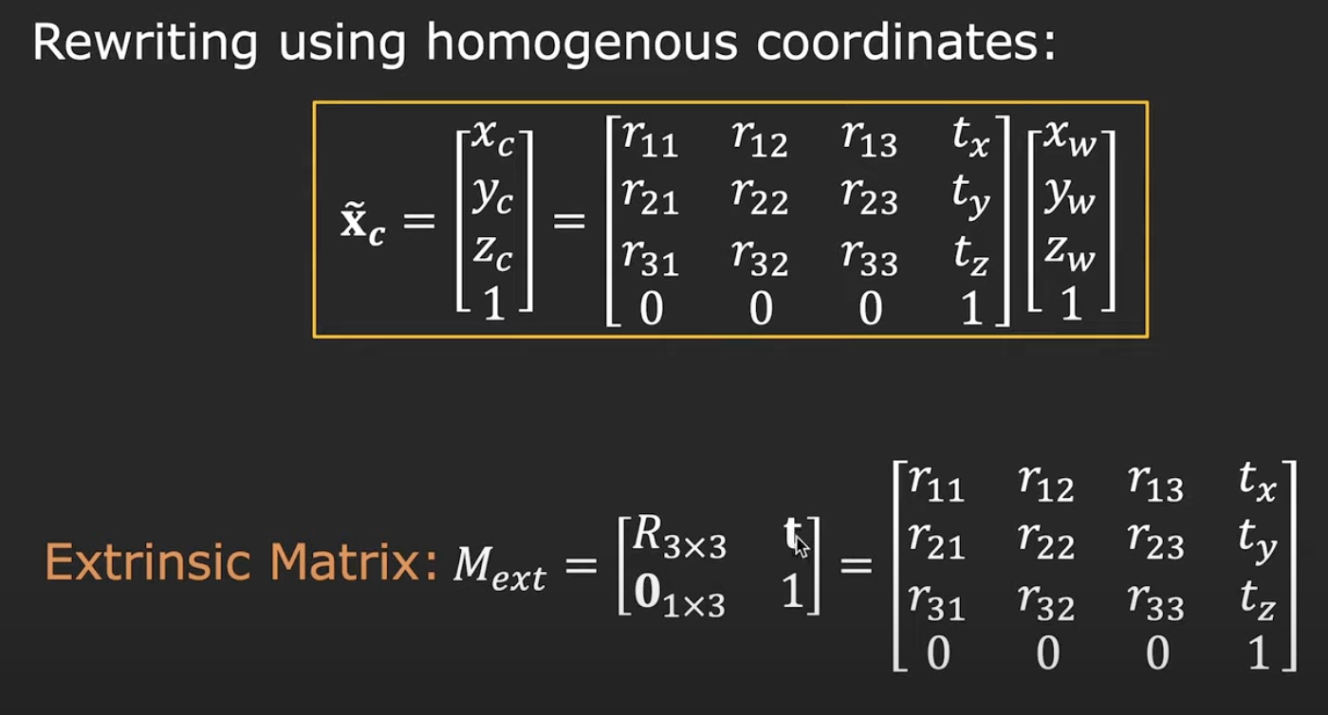

In 3D Space: World-to-Camera Transformation
$T_{n×n}$ = $\left[\begin{matrix}R_{n×n} & t_{n×1} \\ 0_{1×n} & 1\end{matrix}\right]$
Note: some illustrations taken from https://www.youtube.com/watch?v=qByYk6JggQU

Slide 36
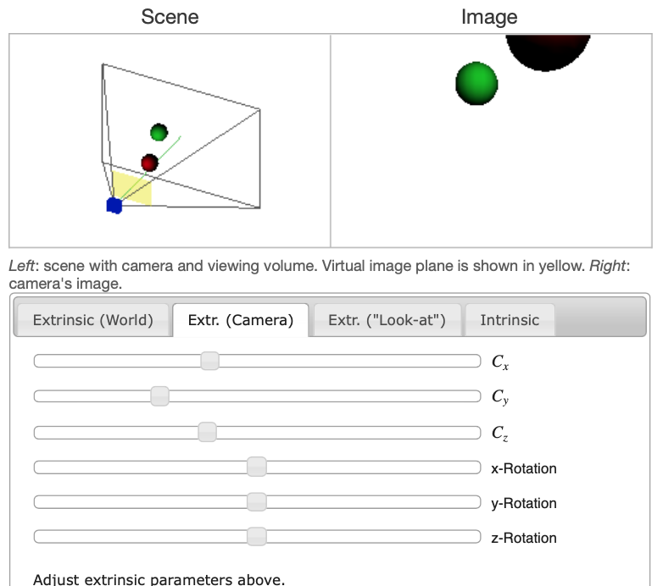
In 3D Space: World-to-Camera Transformation
Interactive demonstration of extrinsic parameters: https://ksimek.github.io/2012/08/22/extrinsic/
Note: some illustrations taken from https://www.youtube.com/watch?v=qByYk6JggQU

Slide 37
Putting It All Together: Forward Projection
Reference: https://docs.opencv.org/4.x/d5/d1f/calib3d_solvePnP.html

Slide 38
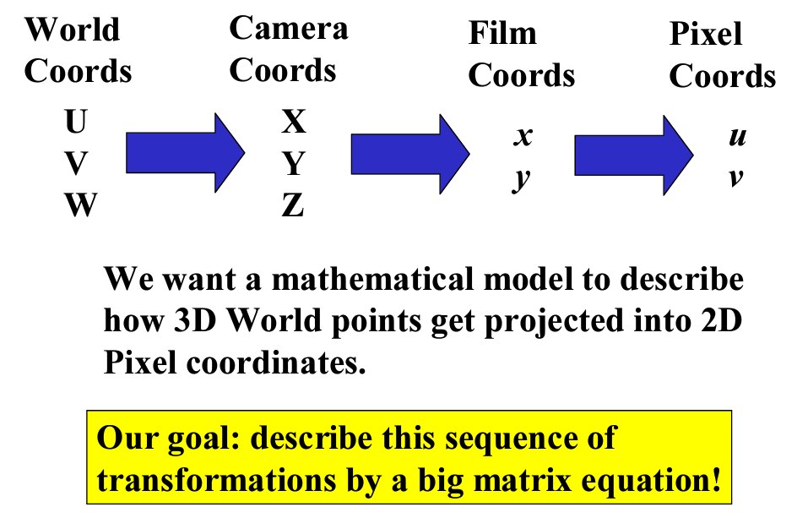
Forward Projection
Reference: https://docs.opencv.org/4.x/d5/d1f/calib3d_solvePnP.html
Slide Credit: CSC492/592, 2024 Spring

Slide 39
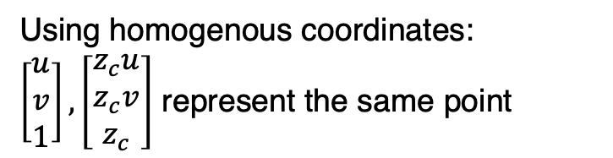
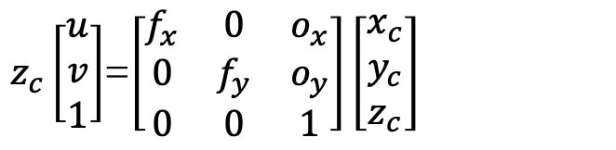
Combining Extrinsic and Intrinsic Matrices
$z_{c}\left[\begin{matrix}u \\ v \\ 1\end{matrix}\right]$=$\left[\begin{matrix}f_{x} & 0 & o_{x} \\ 0 & f_{y} & o_{y} \\ 0 & 0 & 1\end{matrix}\right]\left[\begin{matrix}x_{c} \\ y_{c} \\ z_{c}\end{matrix}\right]$
Using homogenous coordinates:
$\left[\begin{matrix}u \\ v \\ 1\end{matrix}\right], \left[\begin{matrix}z_{c}u \\ z_{c}v \\ z_{c}\end{matrix}\right]$ represent the same point
Note: some illustrations taken from https://www.youtube.com/watch?v=qByYk6JggQU

Slide 40
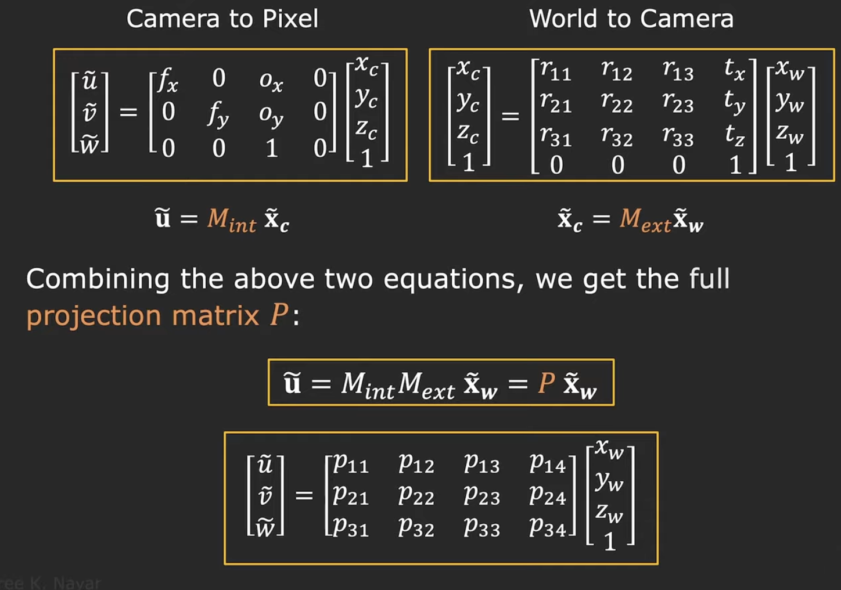
Projection Matrix P
Note: some illustrations taken from https://www.youtube.com/watch?v=qByYk6JggQU

Slide 41
Takeaway
Image formation?
Perspective projection / Coordinate transformation?
Intrinsic / Extrinsic matrix?
Projection matrix?
Questions?

